Slide 1
Hybrid Solar Irradiance using Kalman Filter
To Dr. Sumanta Pasari, Department of Mathematics, BITS Pilani, Pilani Campus
By Uday Mittal
2019B4A70662P

Slide 2
Work Done Till Mid-semester
Got a thorough understanding of the Research paper provided by Dr. Sumanta Pasari “Hybrid solar irradiance now-casting by fusing Kalman filter and regressor,” presented by Dr. Hsu-Yung-Cheng, Department of Computer Science and Information Engineering, National Central University, Taiwan.
Got a thorough understanding of the working of Kalman Filter, theorietically.

Slide 3
My Goals After Mid-semester
Try finding the code for the research article, written by the author.
Modify the code, so as to make it compatible with the Indian Dataset.
Implementation of the Kalman Filter on the Indian dataset downloaded from the National Solar Radiation Database (NSRDB) website NSRDB Data Viewer (nrel.gov)

Slide 4
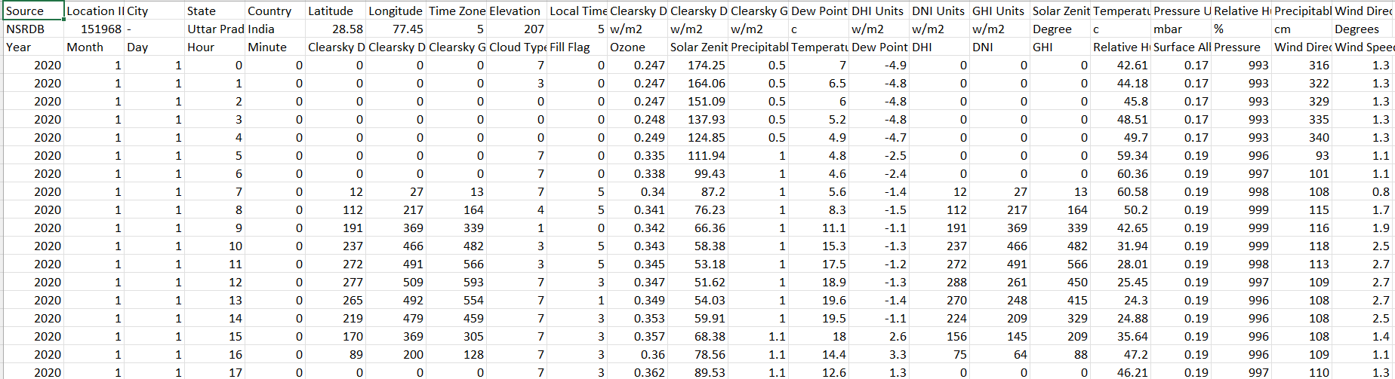
Indian Dataset
The location ID of the data is 37992.
The data is from Uttar Pradesh, India.
The latitude of the data is 28.57, and the longitude is 77.46.
The snapshot of the data is attached below.

Slide 5
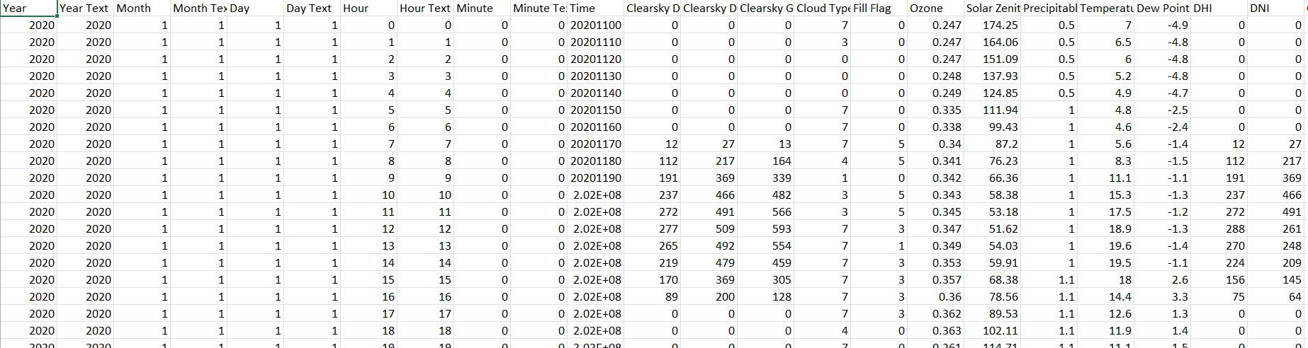
The data is not fit to be used as it is.
It has to be cleaned, and certain unique values has to be added, so that the distinction between the different data points could be made.
A unique key has been added into the data, which identifies the data points, named “Time”.
It is made by concatenating Year, Month, Day, Hour, and Minute, to form the unique key.
Additionally the data of the location, SI values, etc. has also been removed.
A snapshot of the processed data has been attached.

Slide 6
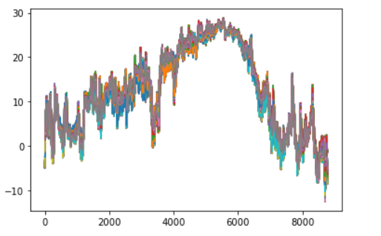
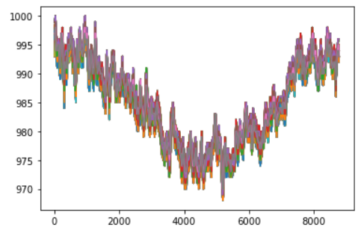


The next task was to analyse the data, and to get an insight of the what the data looks like.
For this, I plotted certain curves, depicting the nature of data, and how much data is related to each other.
First some data sets are plotted, which remains constant for all hours, in a day.
Pressure
Dew Point

Slide 7
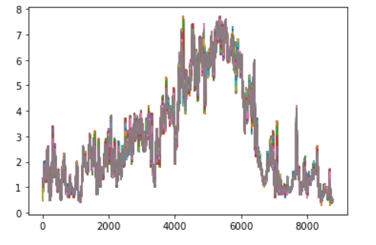
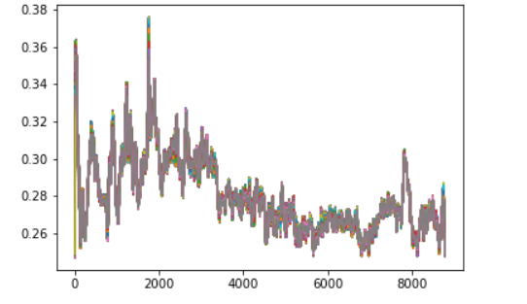


Precipitable Water
Ozone

Slide 8
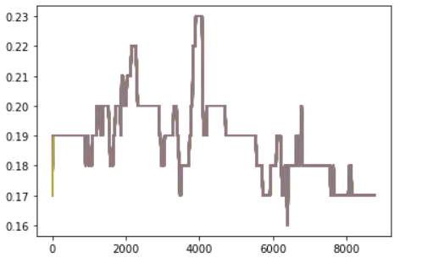
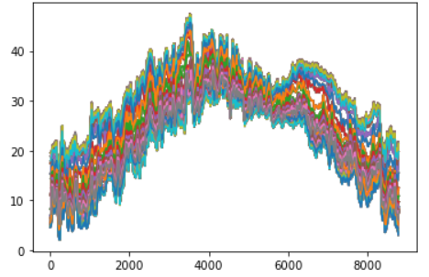


Surface Albedo
Temperature
Surface Albedo quantifies the fraction of sunlight reflected by the surface of the Earth
Surface Albedo | Copernicus Global Land Service

Slide 9
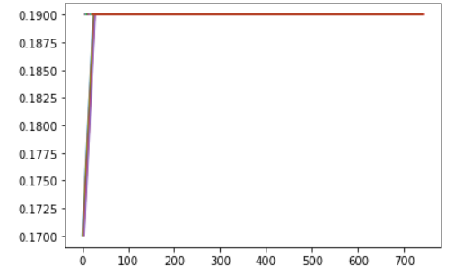
The data parameters plotted above remain almost constant at a particular time, for all the hourly classification.
They can therefore be used to set a reference for the further experiments which has to be conducted.
The best among them is Surface Albedo, as it remains constant for a long duration of time, and the width of the line in the graph is less, meaning that the difference in the values between different times is very-very less.
Below is the Surface Albedo plot, classified on hourly basis, for the month of January.
The data is smooth, except for a single point, and is constant as well.

Slide 10
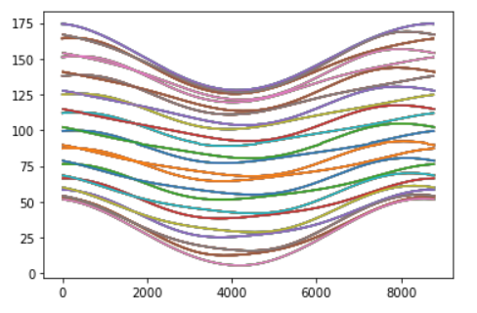
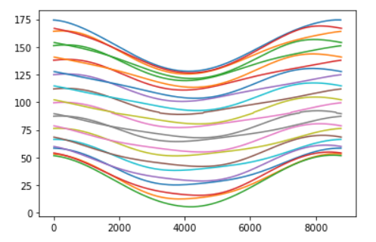

Some Interesting Plots
Solar Zenith Angle
Data Classified Based on Hour, in the whole year
Monthly Classification of the data
Solar Zenith Angle is the angle between the sun’s rays and the vertical direction.
It does not depend on the day, rather it depends only on the hour at which it is calculated.
Solar zenith angle - Wikipedia

Slide 11
DHI – Diffuse Horizontal Irradiance - The solar radiation that does not arrive on a direct path from the sun but has scattered by the clouds and particles in the atmosphere and comes equally from all directions.
DNI - Direct Normal Irradiance - The amount of light that is coming perpendicular to a surface. This type of irradiance belongs to rays that come in a straight line from the direction of the sun at its current position in the sky.
GHI - Global Horizontal Irradiance - Total amount of shortwave radiation received from above by a surface which is horizontal (parallel) to the ground.
GHI = DNI * cos(Solar Zenith Angle) + DHI
https://www.yellowhaze.in/solar-irradiance/

Slide 12
Kalman Filter
Kalman Filtering is carried out in two steps:
Prediction
Update
Kalman filter is a mathematical tool used for stochastic estimation from noisy sensor measurements.
The Kalman filter is a set of mathematical equations that implement a predictor-corrector type estimator that is optimal in the sense that it minimizes the estimated error covariance when some presumed conditions are met.

Slide 13
Kalman Filter Implementation
To implement Kalman Filter, I used Python.
Python has two libraries available to implement Kalman Filter.
They are
simdkalman
filterpy.kalman
Parameters used –
X – The mean state estimate of the previous step (k-1)
P – The state covariance of previous step (k-1)
A – The transition nxn matrix
Q – The process noise covariance matrix
B – The input effect matrix
U – The control input

Slide 14
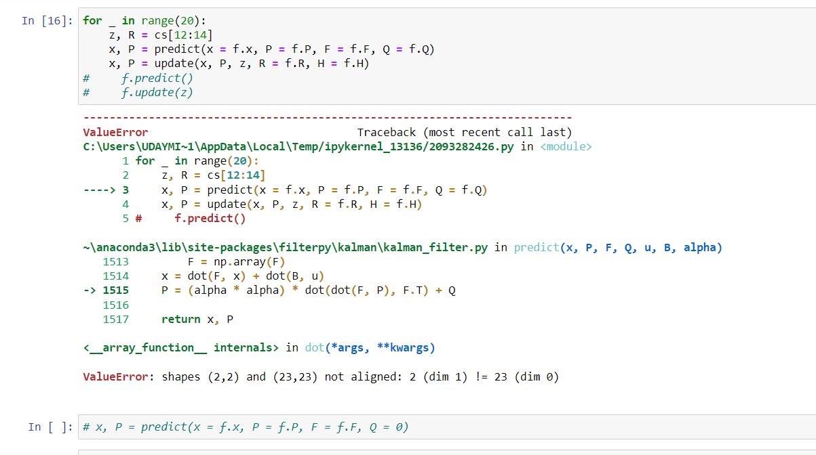

Slide 15
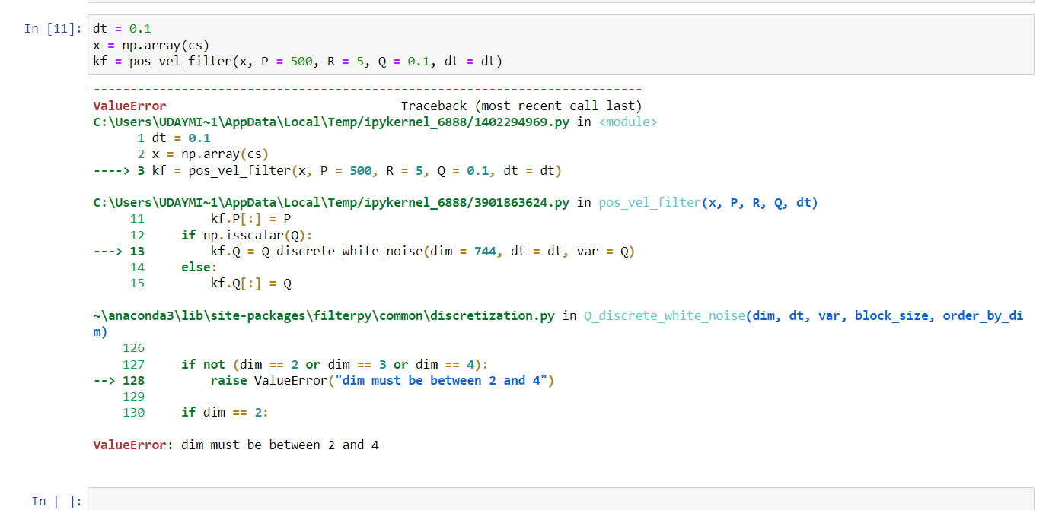
Error Encountered while implementing filterpy.kalman

Slide 16
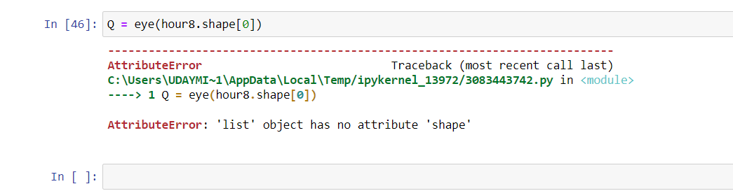
Error Encountered when trying to implement the Kalman Filter, without using any library.
Just using pure programming knowledge to implement the algorithm

Slide 17
Challenges Faced
The research work was done under the Ministry of Science and Technology, Taiwan under the project code 104-2221-E-008-083.
The code is not publicly available, due to being the government project.
Several attempts to contact the author failed as no reply from her side was obtained regarding making the code available.
Several attempts to implement the Kalman filter on python failed, due to several reasons, at all times.
No proper code is written from my end, implementing the Kalman filter on Indian Dataset.

Slide 18
Future Work
The future work would majorly consist of few things. They are indicated below
Application of Kalman filter in MATLAB and R, instead of Python.
Modifying the code which has been written by me, and trying if it can work further.
Trying contacting the author for some insight and code.
I have open sourced my work, along with my failures.
The link for the github profile is Uday-Mi/Study-Project (github.com)
The future researchers can use this code and can further modify it.

Slide 19
References
NSRDB Data Viewer (nrel.gov)
Surface Albedo | Copernicus Global Land Service
Solar zenith angle – Wikipedia
https://www.yellowhaze.in/solar-irradiance/
https://github.com/rlabbe/Kalman-and-Bayesian-Filters-in-Python/blob/master/07-Kalman-Filter-Math.ipynb
https://arxiv.org/ftp/arxiv/papers/1204/1204.0375.pdf
https://simdkalman.readthedocs.io/en/latest/
https://www.kaggle.com/code/emaerthin/demonstration-of-the-kalman-filter/notebook

